Slide 1
Introduction au Git

Slide 2
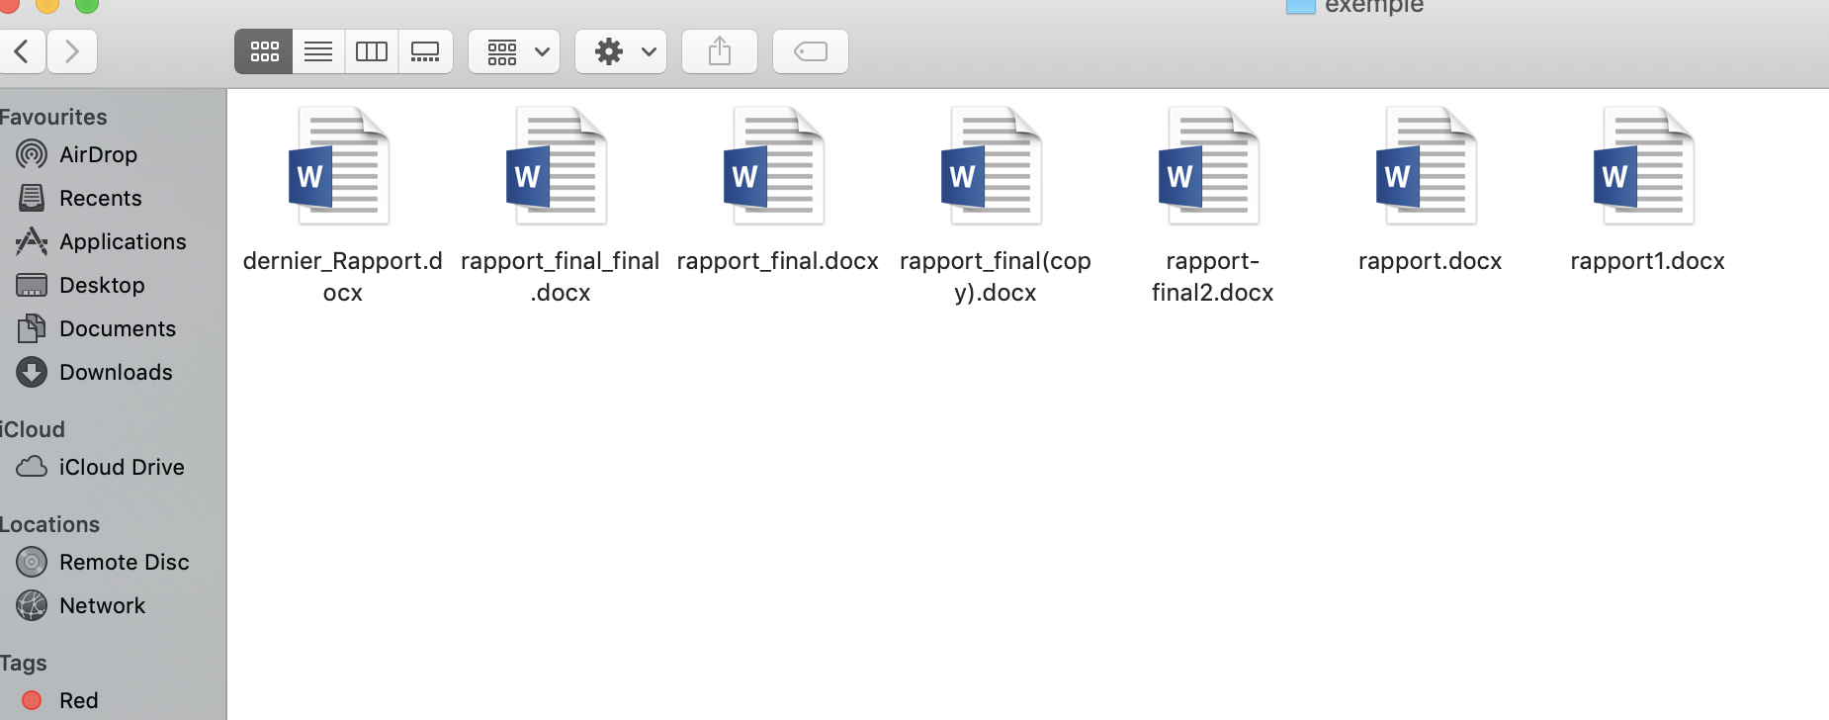
Pourquoi ?
Quelle est la derniere version de mon rapport ? 🧐
Oops j’ai modifier la mauvaise version 😖
Ohh non j’ai supprimer le mauvais fichier !! 😱

Slide 3
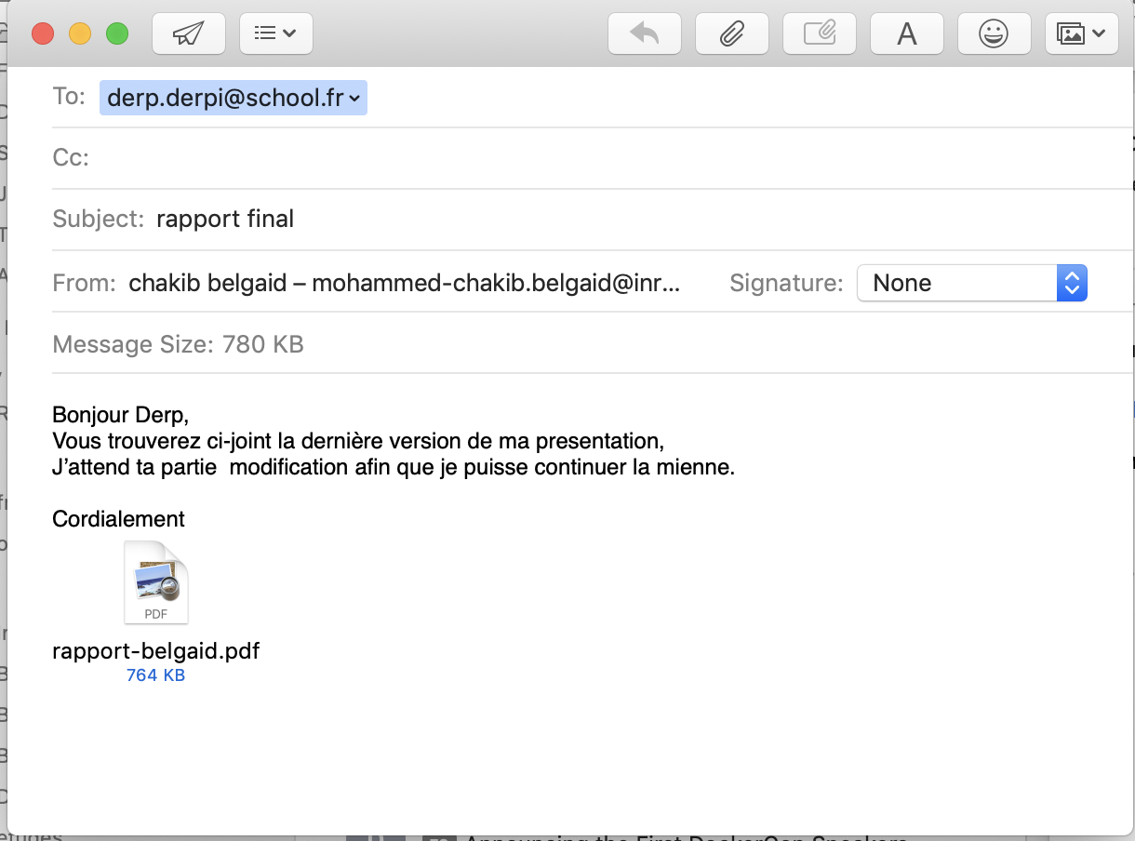
Pourquoi ?
Notes:
.Mon collegue est moi travaillons sur le meme rapport
. Un echage des emails entre nous

Slide 4
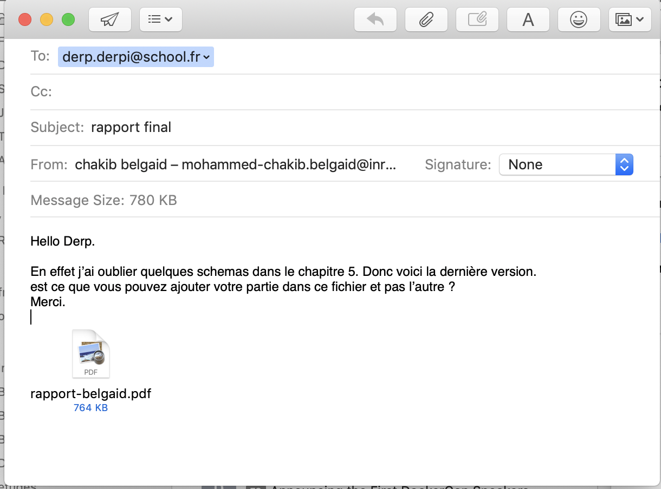
Pourquoi ?
Notes:
J’ai oublier quelques modifications,
il faut qu’il ajoute ses modification dans la nouvelle version et pas celle qui a deja commencer a travailler dessus.

Slide 5
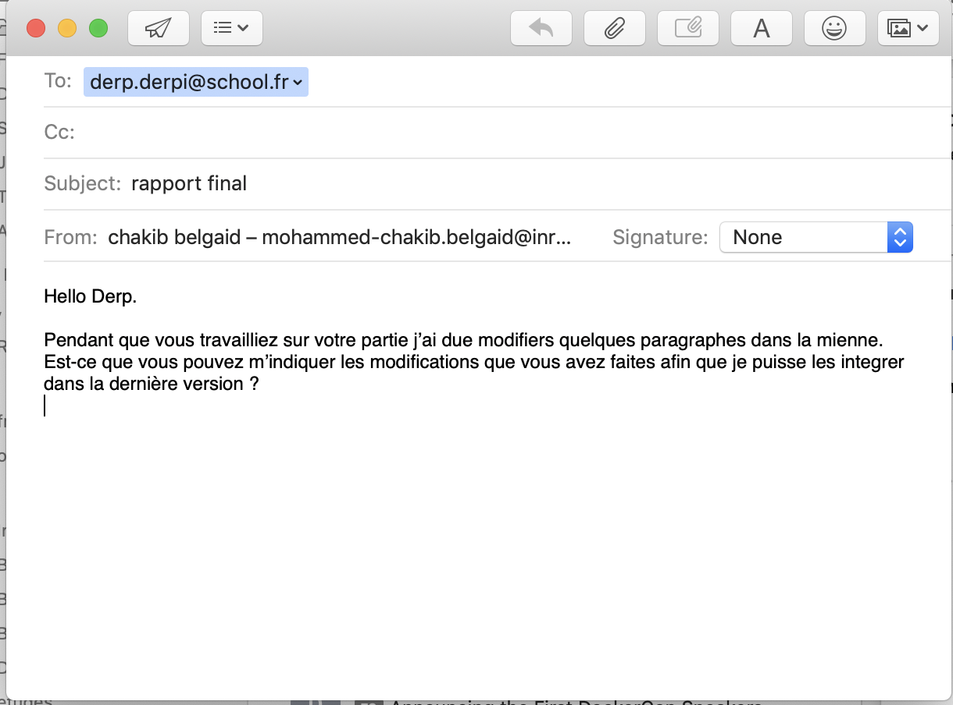
Pourquoi ?
Notes:
La partie integration est la plus difficile ,et elle demande un travaille manuelle.

Slide 6
Pourquoi ?
Travailler seul
Travailler sur plusieurs versions d’un meme fichier demande beacoup d’effort.
On risque souvent de se tromper dans la dernierre version.
On risuqe de payer cher pour des erreurs d’innatention
En collaboration
difficile de travailler simultanement sur le meme fichier .
Perdre du temps dans la communication.
Un travail mauelle pour regrouper les parties de chaque participant

Slide 7
Solution
Laisser la gestion a la machine
Utiliser un logiciel qui fait la gestion des version a notre place

Slide 8
Solution
I am Jayden Smith
I am here because I love to give presentations.
You can find me at @username

Slide 9
Transition headline
Let’s start with the first set of slides

Slide 10
Quotations are commonly printed as a means of inspiration and to invoke philosophical thoughts from the reader.

Slide 11
This is a slide title
Here you have a list of items
And some text
But remember not to overload your slides with content
You audience will listen to you or read the content, but won’t do both.

Slide 12
Big concept
Bring the attention of your audience over a key concept using icons or illustrations

Slide 13
You can also split your content
White
Is the color of milk and fresh snow, the color produced by the combination of all the colors of the visible spectrum.
Black
Is the color of coal, ebony, and of outer space. It is the darkest color, the result of the absence of or complete absorption of light.

Slide 14
In two or three columns
Yellow
Is the color of gold, butter and ripe lemons. In the spectrum of visible light, yellow is found between green and orange.
Blue
Is the colour of the clear sky and the deep sea. It is located between violet and green on the optical spectrum.
Red
Is the color of blood, and because of this it has historically been associated with sacrifice, danger and courage.

Slide 15

A picture is worth a thousand words
A complex idea can be conveyed with just a single still image, namely making it possible to absorb large amounts of data quickly.

Slide 16
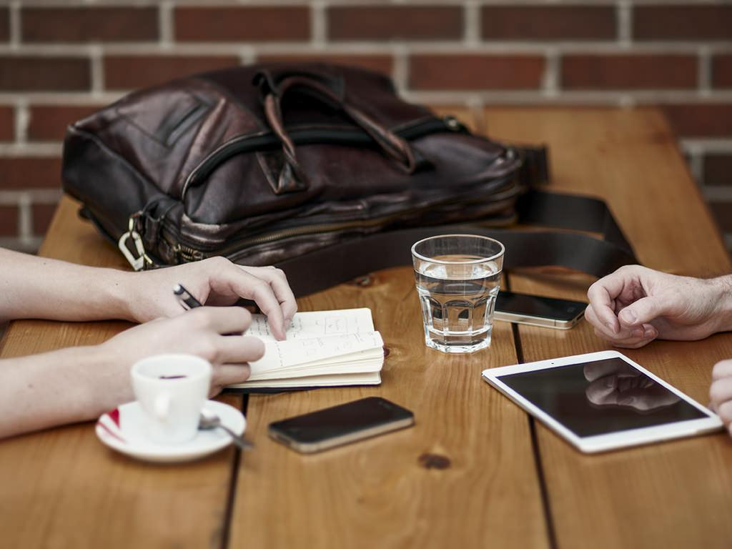
Want big impact? Use big image.

Slide 17
Use charts to explain your ideas
White
Gray
Black

Slide 18
And tables to compare data
 | A | B | C
Yellow | 10 | 20 | 7
Blue | 30 | 15 | 10
Orange | 5 | 24 | 16

Slide 19
Maps
our office

Slide 20
89,526,124
Whoa! That’s a big number, aren’t you proud?

Slide 21
89,526,124$
185,244 users
100%
That’s a lot of money
And a lot of users
Total success!

Slide 22
Our process is easy
first
second
last

Slide 23
Let’s review some concepts
Yellow
Is the color of gold, butter and ripe lemons. In the spectrum of visible light, yellow is found between green and orange.
Blue
Is the colour of the clear sky and the deep sea. It is located between violet and green on the optical spectrum.
Red
Is the color of blood, and because of this it has historically been associated with sacrifice, danger and courage.
Yellow
Is the color of gold, butter and ripe lemons. In the spectrum of visible light, yellow is found between green and orange.
Blue
Is the colour of the clear sky and the deep sea. It is located between violet and green on the optical spectrum.
Red
Is the color of blood, and because of this it has historically been associated with sacrifice, danger and courage.

Slide 24
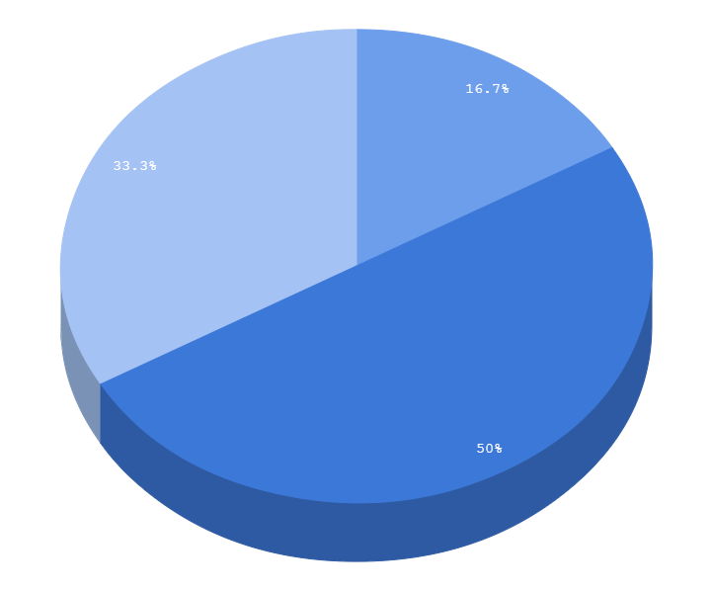
You can copy&paste graphs from Google Sheets

Slide 25
Android Project
Place your screenshot here
Show and explain your web, app or software projects using these gadget templates.

Slide 26
iPhone Project
Place your screenshot here
Show and explain your web, app or software projects using these gadget templates.

Slide 27
Tablet Project
Place your screenshot here
Show and explain your web, app or software projects using these gadget templates.

Slide 28
Desktop Project
Place your screenshot here
Show and explain your web, app or software projects using these gadget templates.

Slide 29
THANKS!
Any questions?
You can find me at
@username
user@mail.me

Slide 30
Credits
Special thanks to all the people who made and released these awesome resources for free:
Presentation template by SlidesCarnival
Photographs by Unsplash

Slide 31

Presentation design
This presentation uses the following typographies and colors:
Titles: Sniglet
Body copy: Dosis
You can download the fonts on this page:
https://www.google.com/fonts#UsePlace:use/Collection:Dosis:200,300,400,500,600,700,800|Sniglet:400
Click on the “arrow button” that appears on the top right
Gray #3d4965
Dark cornflower blue #3c78d8
You don’t need to keep this slide in your presentation. It’s only here to serve you as a design guide if you need to create new slides or download the fonts to edit the presentation in PowerPoint®

Slide 32
SlidesCarnival icons are editable shapes.
This means that you can:
Resize them without losing quality.
Change fill color and opacity.
Isn’t that nice? :)
Examples:

Slide 33
😉
Now you can use any emoji as an icon!
And of course it resizes without losing quality and you can change the color.
How? Follow Google instructions https://twitter.com/googledocs/status/730087240156643328
✋👆👉👍👤👦👧👨👩👪💃🏃💑❤😂😉😋😒😭👶😸🐟🍒🍔💣📌📖🔨🎃🎈🎨🏈🏰🌏🔌🔑 and many more...

